Slide 1
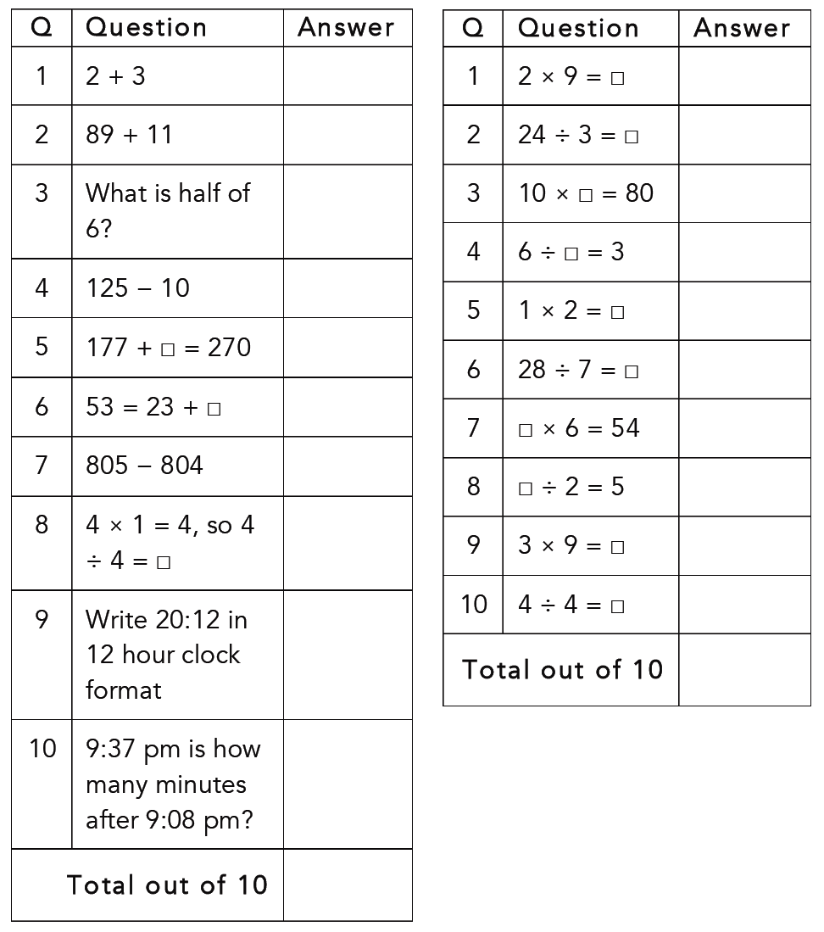












Numeracy Ninjas
Your time is up!
Get ready to mark your answers

Slide 2

Week 1 Session 1
Mental Strategies Answers
Q | Question | Answer
1 | 2 + 3 | 5
2 | 89 + 11 | 100
3 | What is half of 6? | 3
4 | 125 − 10 | 115
5 | 177 + ☐ = 270 | 93
6 | 53 = 23 + ☐ | 30
7 | 805 − 804 | 1
8 | 4 × 1 = 4, so 4 ÷ 4 = ☐ | 1
9 | Write 20:12 in 12 hour clock format | 8:12 pm
10 | 9:37 pm is how many minutes after 9:08 pm? | 29

Slide 3
Week 1 Session 1
Timestables Answers
Q | Question | Answer
1 | 2 × 9 = ☐ | 18
2 | 24 ÷ 3 = ☐ | 8
3 | 10 × ☐ = 80 | 8
4 | 6 ÷ ☐ = 3 | 2
5 | 1 × 2 = ☐ | 2
6 | 28 ÷ 7 = ☐ | 4
7 | ☐ × 6 = 54 | 9
8 | ☐ ÷ 2 = 5 | 10
9 | 3 × 9 = ☐ | 27
10 | 4 ÷ 4 = ☐ | 1

Slide 4
0-2
3-4
5-6
7-8
9-10
11-12
13-14
15-16
17-18
19-20
Calculate your Ninja Score to see which Ninja Belt you’ve earned today!

Slide 5
Like Terms and Substitution
Miss L
Year 7

Slide 6
24
7
30
Like Terms and Substitution
Date
EQ – How do we add like terms and substitute varibles?
How do we Substitute?
When a variable in a formula is replaced by a number, we say that number is substituted into the formula

Slide 7


Slide 8
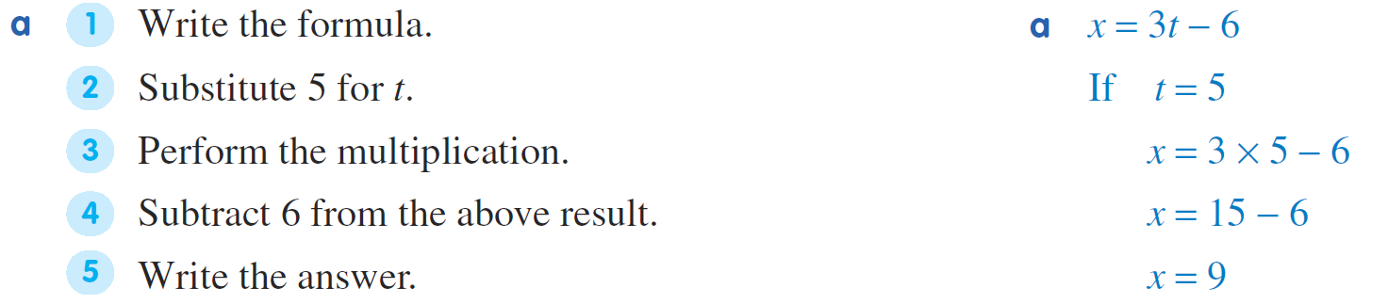
Practice

Slide 9
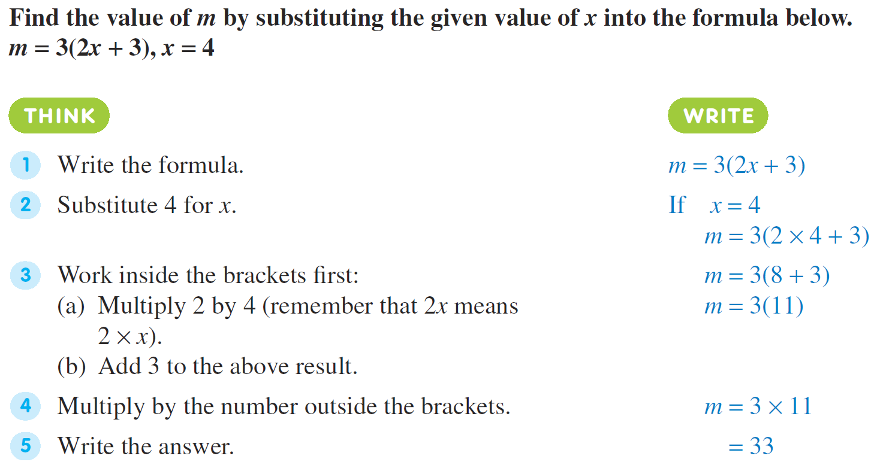

Slide 10
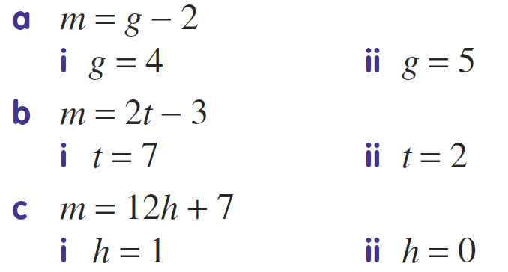
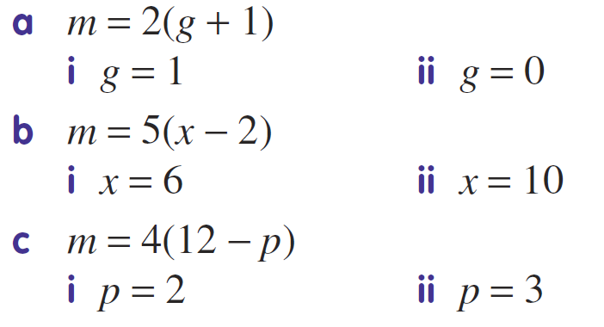
Task

Slide 11
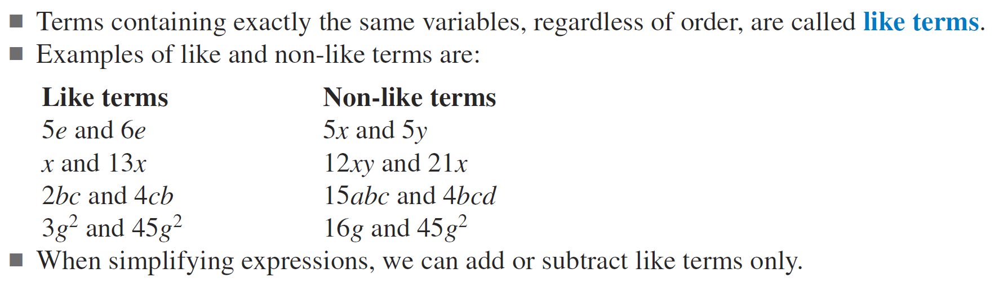
24
7
30
Like Terms and Substitution
Date
EQ – How do we add like terms and substitute varibles?
What are like terms?

Slide 12
Practice

Slide 13
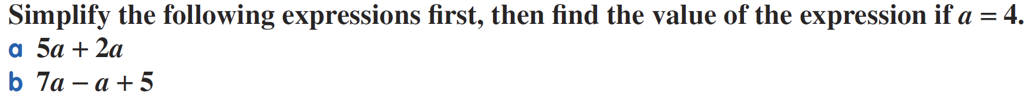

Slide 14
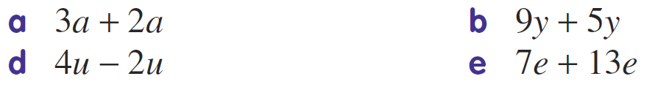
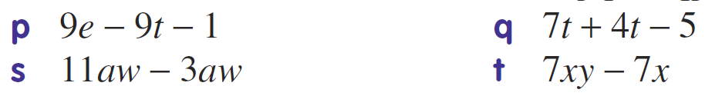
Task

